Slide 1
WEB 322 WEB PROGRAMMING TOOLS AND FRAMEWORKS
WEEK 6 - LECTURE 2
DotEnv, SendGrid, Heroku

Slide 2

Cloud-Based Email

Slide 3
SendGrid
A cloud-based SMTP provider.
Allows you to send emails without having to maintain email servers.
Easy to integrate using SendGrid API and Node.js modules.
Setup:
Register for an account at: https://sendgrid.com/
Create an API Key using the SendGrid dashboard.
Install the SendGrid API module: npm install “@sendgrid/mail”
Import the module, set the API key, construct your email, and send.

Slide 4
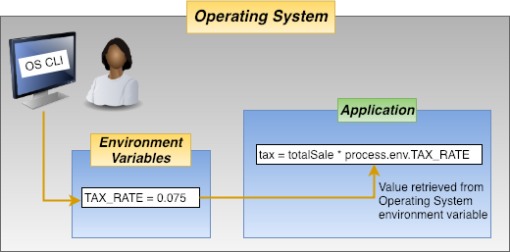
Environment Variables

Slide 5
Environment Variables
A variable whose value is set outside the program.
Typically read/written using functionality of the Operating System.
Made up of a name/value pair.
Any number of variables may be created and available for reference.
Primarily used:
To limit the need to modify and re-release an application due to changes in the configuration data.
To secure (or remove) configuration data from source control systems like GIT.

Slide 6
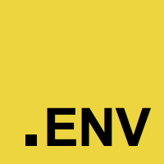
dotenv
A module that loads environment variables from a .env file into process.env.
Based on The Twelve-Factor App methodology.
Setup:
Install the package: npm install dotenv
Create a .env file in your project.
Add environment-specific variables on new lines in the form NAME=VALUE.
Import (require) the package: require(‘dotenv’).config({path:”./path”})

Slide 7


